Slide 1
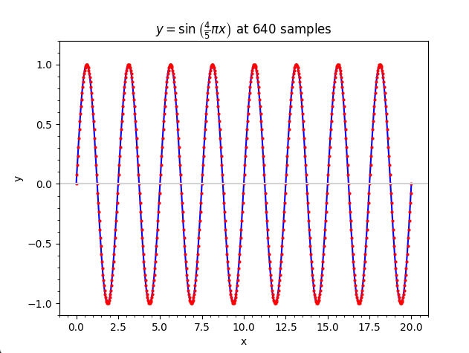
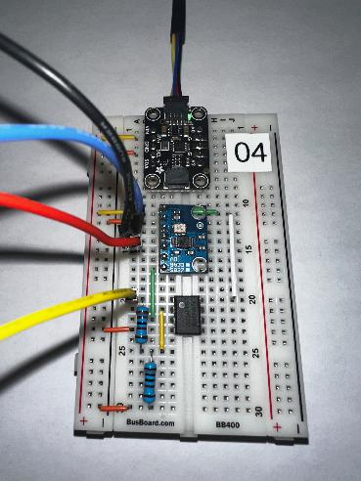
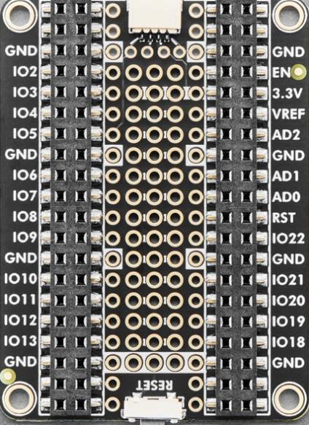
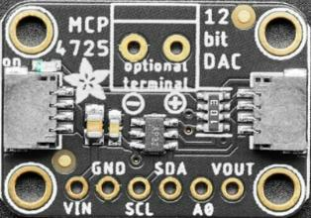
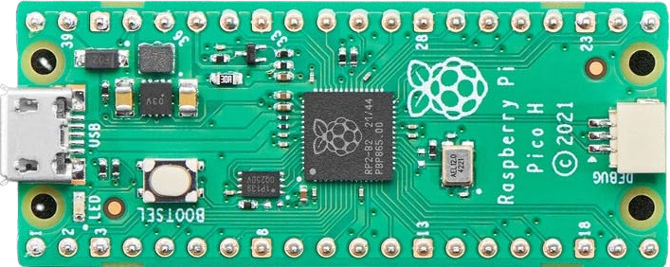
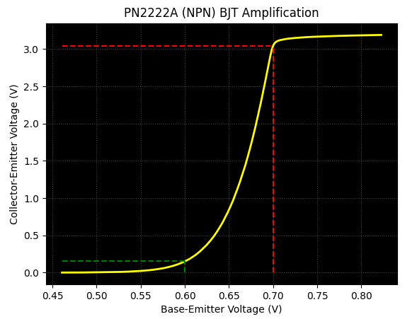

Control System Electronics 101
Using Python and Sensors to Measure Circuits
Board 05
Decibels,
Twin-T Notch Filter, Harmonics
Dave Biersach
dbiersach@bnl.gov

Slide 2
Board 05 – Goals
Define the concept of a decibel, and identify why it is a useful measure in signal analysis
Calculate the relationship between -3dB and the halving of a signal’s power/intensity
Examine the range of human hearing in terms of Hertz
Consider the difference between a sine wave and a square wave in terms of higher-order harmonics
Review simple passive RC filters (low pass and high pass)
Construct a Twin-T Notch filter circuit and evaluate its band-stop capabilities

Slide 3
A Decibel (1/10th of a Bel)
Origin: The decibel (dB) was developed at Bell Telephone Laboratories in the 1920s to quantify signal loss over telephone lines. It is named after Alexander Graham Bell
Logarithmic ratio: A decibel expresses the ratio between two power levels as 10·log₁₀(P₂/P₁), compressing huge dynamic ranges into manageable numbers
Human perception: Our ears perceive loudness logarithmically — a 10 dB increase sounds roughly twice as loud — making dB a natural fit for audio work
Reference standards: Absolute measurements require a reference scale/unit; common ones include dBm (1 mW) and dBV (1 volt)

Slide 4
Decibels
Additive convenience: Because logs turn multiplication into addition, cascaded gains and losses simply add: a 20 dB gain amplifier feeding into a 6 dB cable loss yields +14 dB overall
Universal adoption: Decibels appear across electronics, acoustics, RF engineering, and signal processing wherever signals span many orders of magnitude
Some examples:
An amplifier with 1 W input and 100 W output: 10·log₁₀(100/1) = +20 dB gain
A cable losing half the signal power: −3 dB
Feeding 50 mW into a system referenced to 1 mW: 10·log₁₀(50/1) ≈ +17 dBm
A voltage divider cutting voltage to 1/10: 20·log₁₀(0.1) = −20 dB

Slide 5
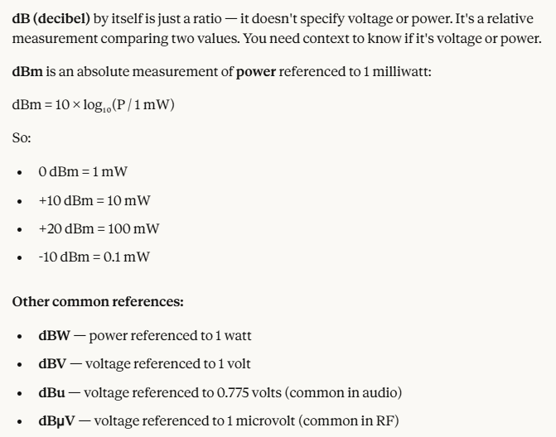
Decibels
①
②
③
④

Slide 6
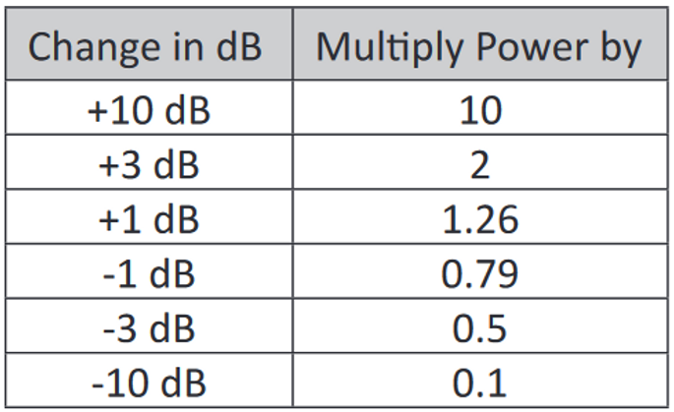
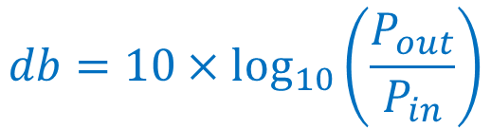
Decibels
$$db=10×\log_{10}\left(\frac{P_{out}}{P_{in}}\right)$$

Slide 7
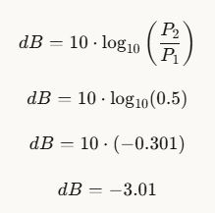
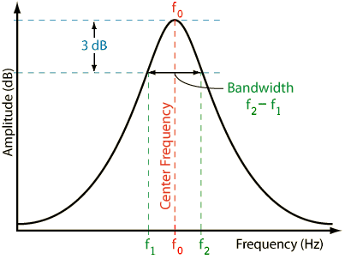

Why -3dB ??
$$−3db$$
50% reduction in power = -3db

Slide 8
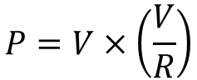
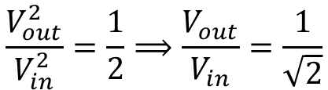
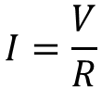
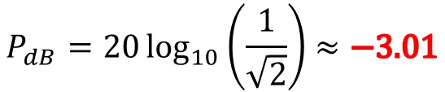
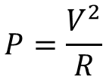
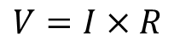
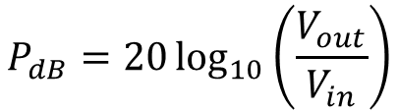
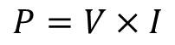
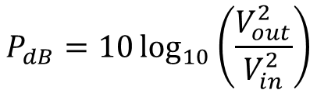
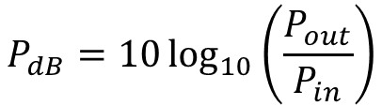
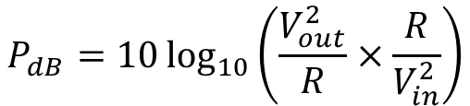
Why -3dB ??
$$P_{dB}=10\log_{10}\left(\frac{V_{out}^{2}}{R}×\frac{R}{V_{in}^{2}}\right)$$
$$V=I×R$$
Ohm’s Law
$$I=\frac{V}{R}$$
$$P_{dB}=10\log_{10}\left(\frac{V_{out}^{2}}{V_{in}^{2}}\right)$$
$$P=V×I$$
Watt’s Law
$$P_{dB}=20\log_{10}\left(\frac{V_{out}}{V_{in}}\right)$$
$$P=V×\left(\frac{V}{R}\right)$$
Log Power Rule
$$P=\frac{V^{2}}{R}$$
$$\frac{V_{out}^{2}}{V_{in}^{2}}=\frac{1}{2}⟹\frac{V_{out}}{V_{in}}=\frac{1}{\sqrt{2}}$$
Cut Power by 50%
$$P_{dB}=10\log_{10}\left(\frac{P_{out}}{P_{in}}\right)$$
$$P_{dB}=20\log_{10}\left(\frac{1}{\sqrt{2}}\right)≈−3.01$$
dB
Definition of a decibel

Slide 9
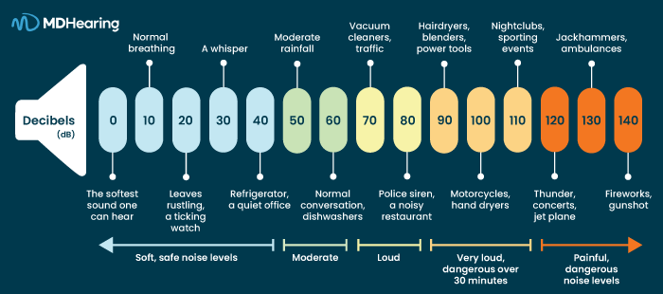
Decibels

Slide 10
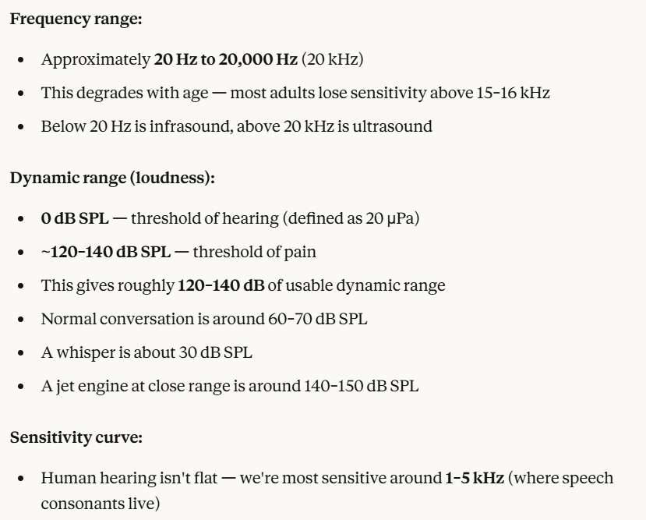
The Range of Human Hearing
①
②

Slide 11
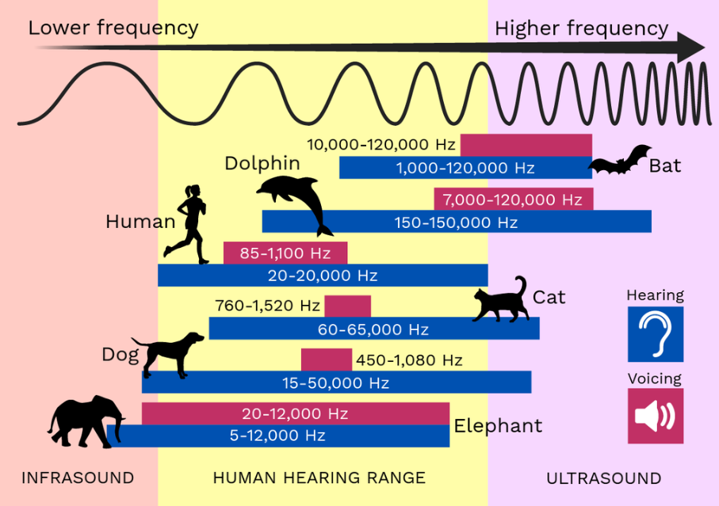

Slide 12
Sine vs. Square Waves
In the first part of this lab, we will use the AD9833 Signal Generator on Board 04 to generate a 723 Hz frequency tone
That frequency is well within the comfortable hearing range of humans – we will attach a speaker to listen to the tone
We will generate both a pure sine wave at 723 Hz and a square wave at 723 Hz
Recall from Topic 01 Fourier Analysis, that a square wave is composed of a series of cosine waves: it is a superposition of an infinite number of odd harmonics that have decreasing amplitudes

Slide 13
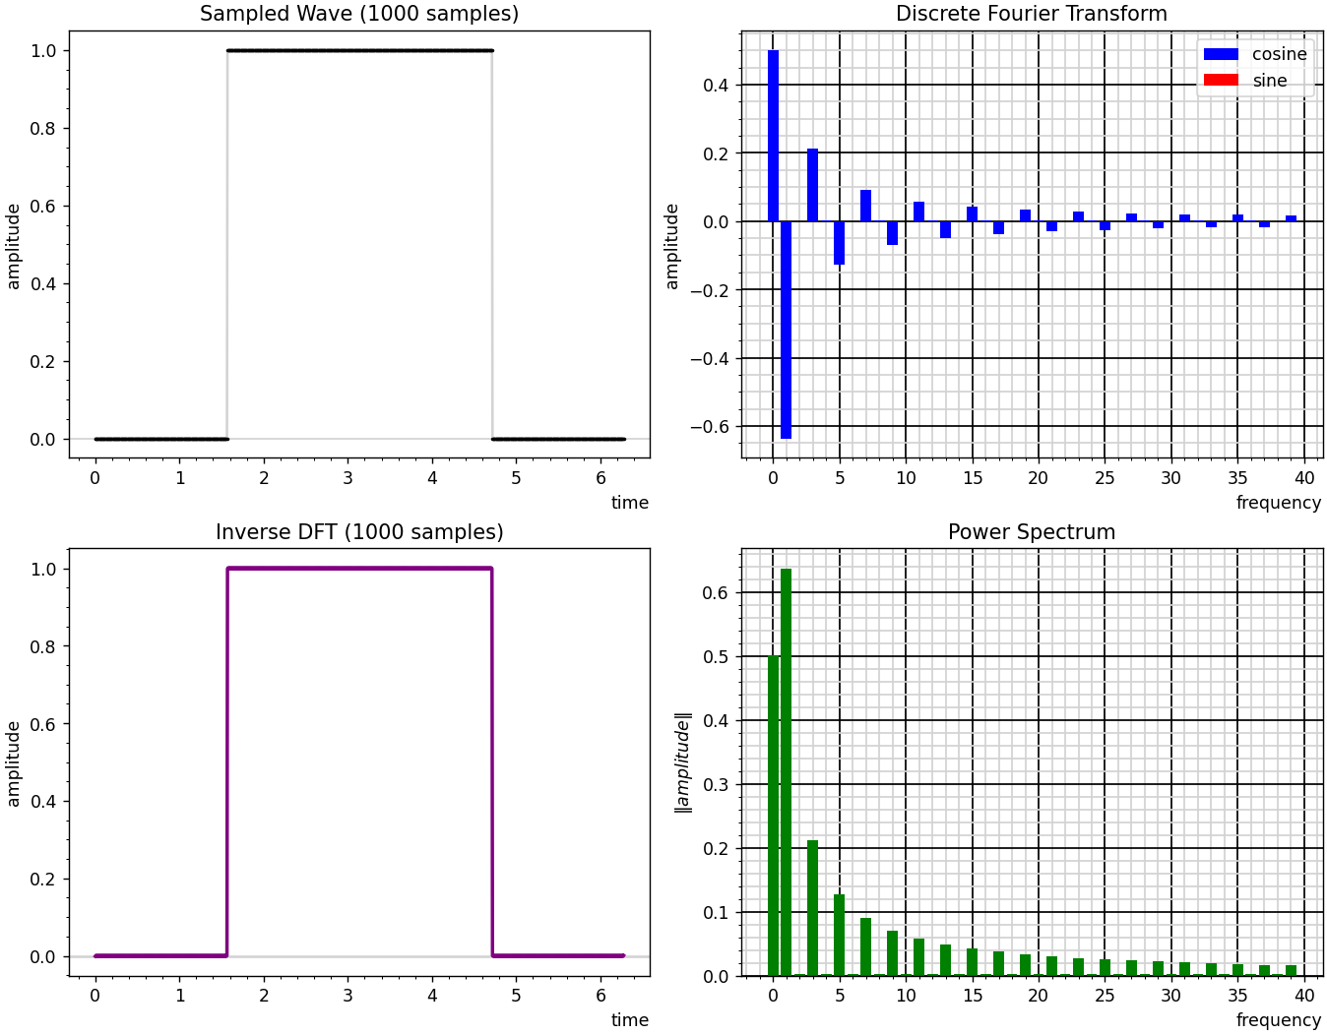
Cosine is an EVEN function -
symmetric around its midpoint
Sine is an ODD function -antisymmetric around its midpoint
Discontinuous jumps can be approximated only by an infinite sum of sinusoids

Slide 14
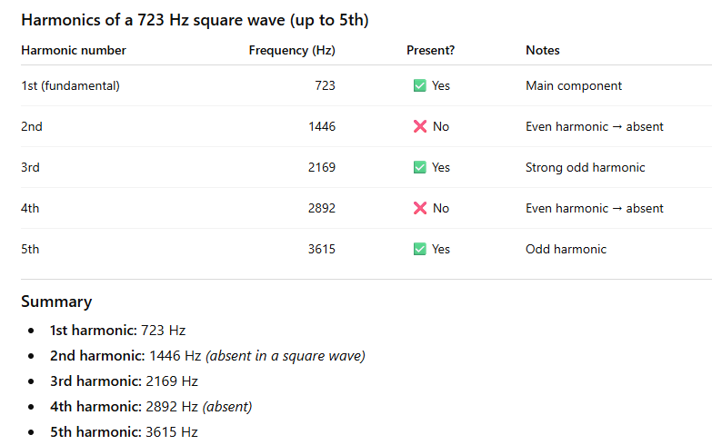
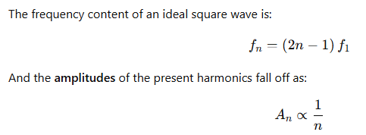
Square Wave – Odd Harmonics Only

Slide 15
Unplug the MCU before changing any wiring!
As we move between each “experiment” on a given breadboard or switch to an entirely new Board #, it is crucial that you FIRST UNPLUG the USB cord!
I recommend unplugging the cord at the PC end – leave the cord connected to the Micro USB port on the Pico
It is dangerous to change any wiring while the MCU is still drawing power from your laptop’s USB port
If you incorrectly connect a jumper wire between the Pico and the breadboard while the Pico is drawing power from your PC, you can permanently damage your PC’s USB port
Have your partner double-check your wiring every step!

Slide 16
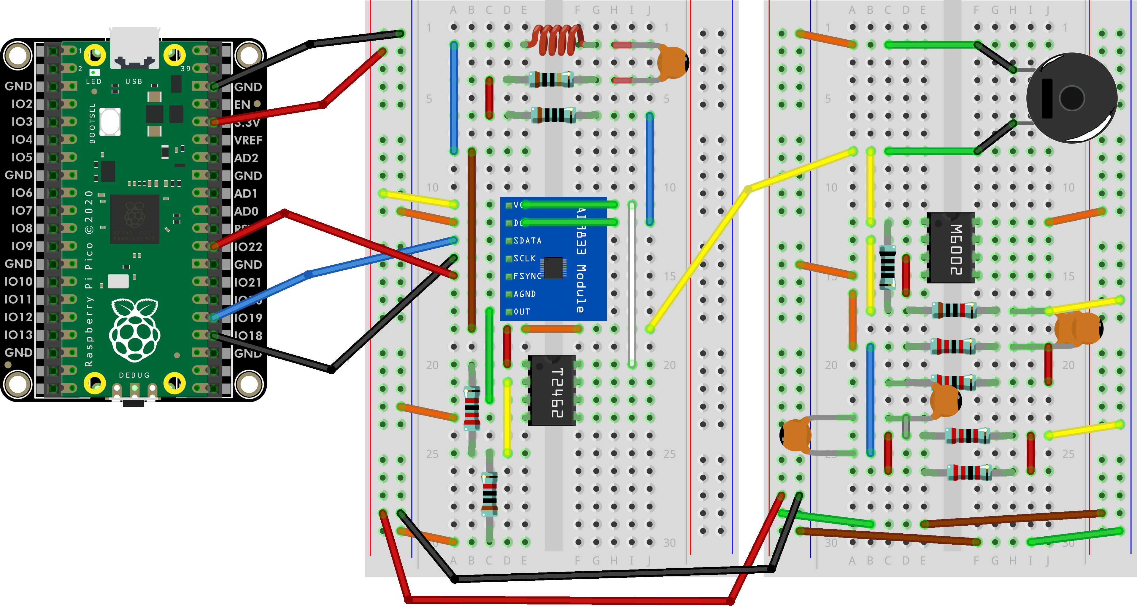
Wire Your Pico to Boards 04 and 05
Board 04
Board 05
(3) BLACK Jumpers
(3) RED Jumpers
BLUE Jumper
(1) YELLOW Jumper

Slide 17
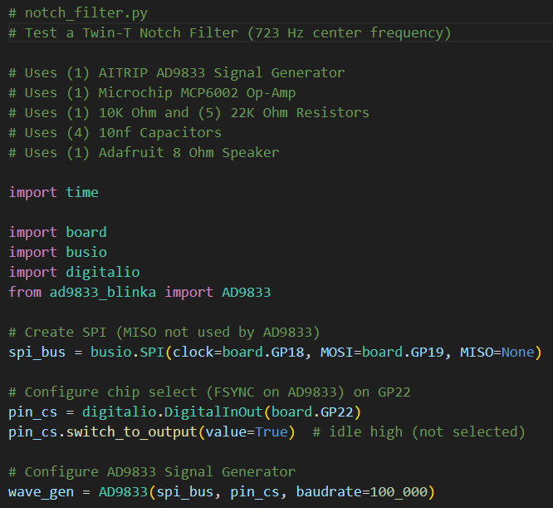
Open notch_filter.py
①
②
③

Slide 18
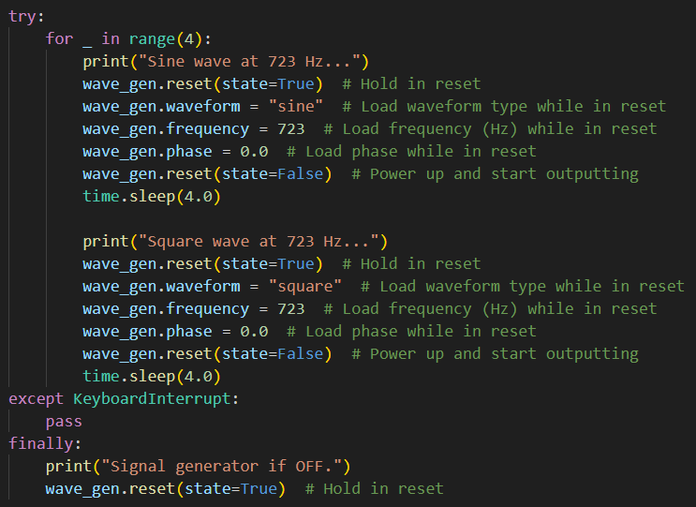
View notch_filter.py
①
②
③
④
⑤
⑥

Slide 19
Connect the Pico to Your PC
If you incorrectly connect a jumper wire between the Pico and the breadboard, you can permanently damage your PC’s USB port!
Have your partner double-check your wiring before you plug in the USB cable back into your PC

Slide 20
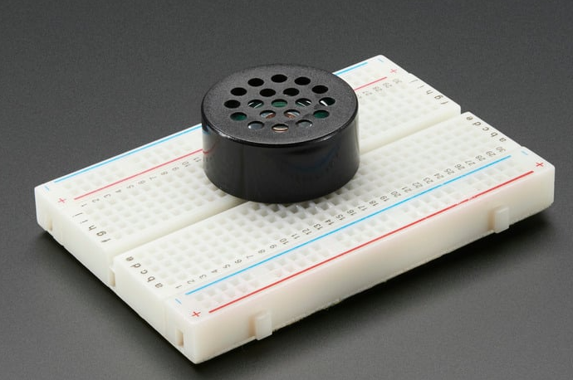
Run notch_filter.py
You should hear the tones in the breadboard speaker
https://www.adafruit.com/product/1898 - $1.85
However, the timbre (tonal quality or color of a sound) of the sine versus the square wave is clearly different, even though they are the exact same frequency (723 Hz)
The odd higher harmonics in the square wave make it sound buzzy
The pure sine wave has only the fundamental harmonic

Slide 21
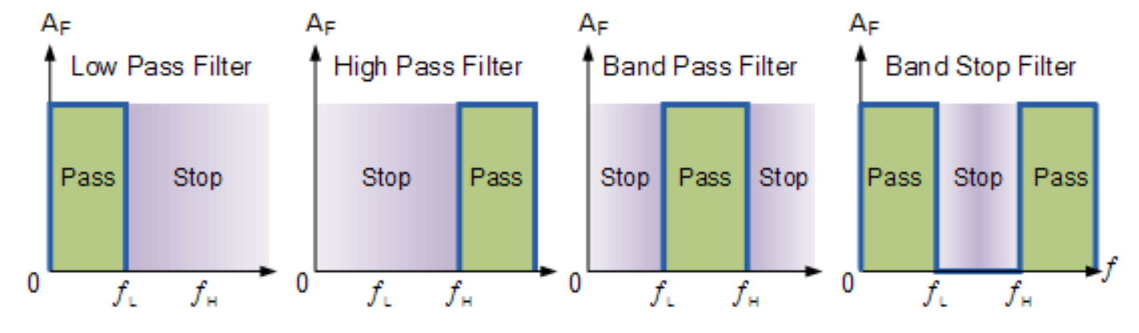
Filter Types
We can design circuits to filter signals.
We can allow or block
ranges of frequencies within a given signal.

Slide 22
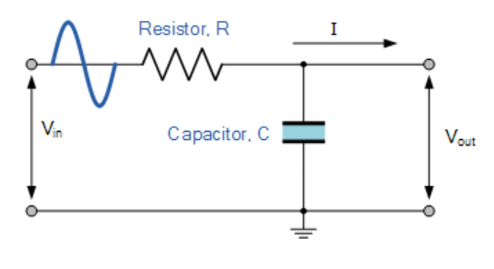
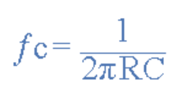
A Passive Low Pass Filter
At high frequencies, the capacitor allows current to easily flow to ground, creating a short circuit and shunting the output
At low frequencies, the capacitor looks like an open circuit and doesn’t interfere with the signal

Slide 23
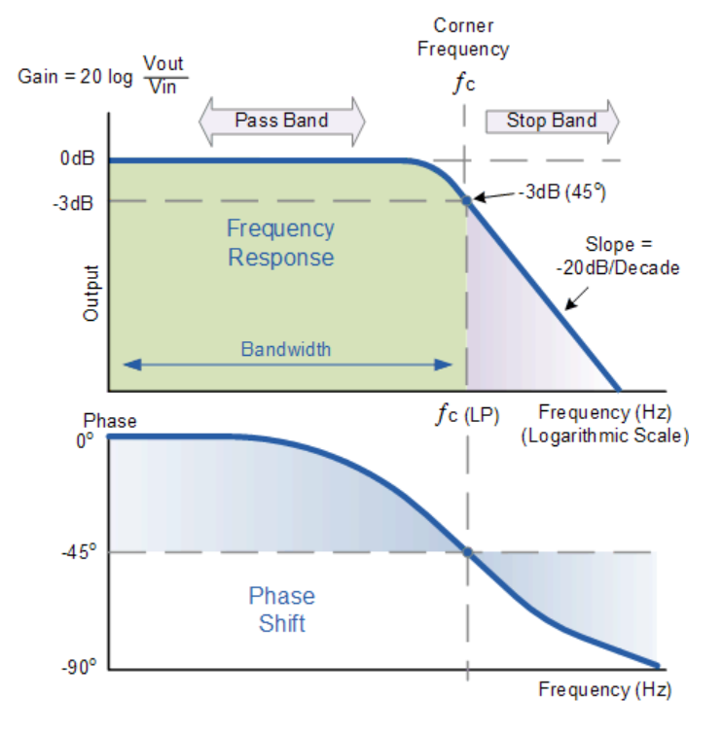
A Passive Low Pass Filter

Slide 24
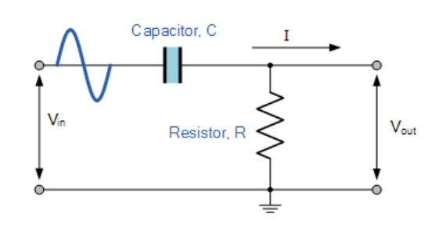
A Passive High Pass Filter
At high frequencies, the capacitor allows current to easily flow through it, and doesn’t interfere with the signal
At low frequencies, the capacitor looks like an open circuit and blocks the signal

Slide 25
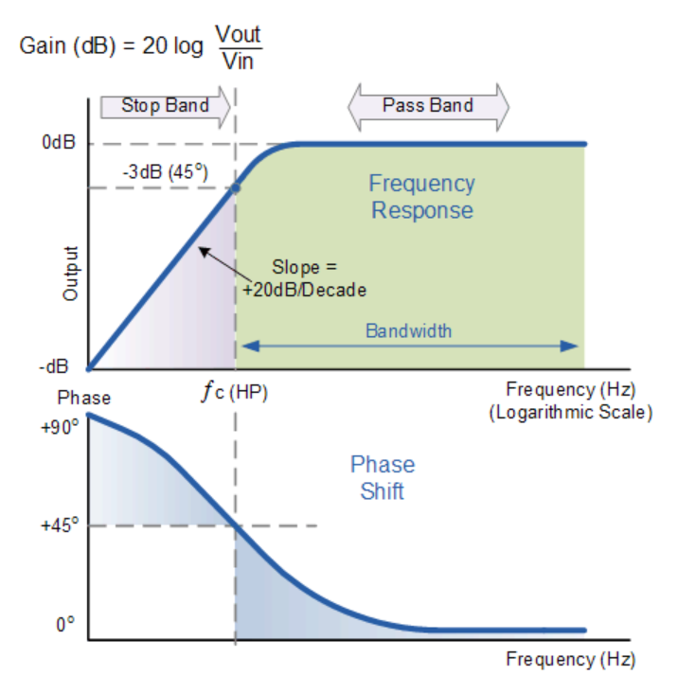
A Passive High Pass Filter

Slide 26
Modelling Low and High Pass Filters
Using software, we can calculate the response of a low-pass and a high-pass filter over a range of input frequencies
If both filters have similar resistors and capacitors, then they will have the same cutoff frequency:
At this special “cutoff” frequency, due to the loading effects of the resistor and capacitor, the signal will have lost 50% of its power, so it is referred to as the -3 dB point
Cutoff really means the point “where attenuation starts to matter” rather than “signal stops here.”

Slide 27
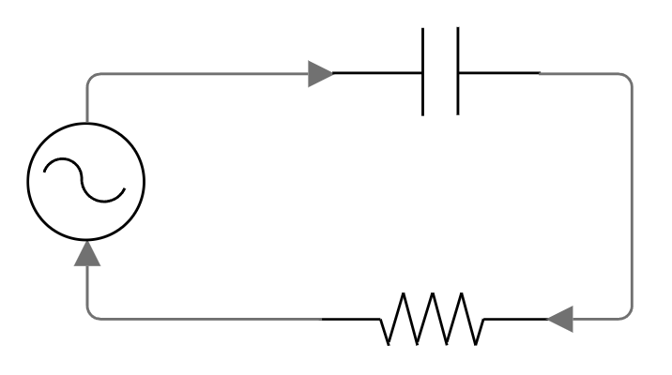

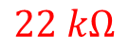
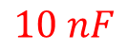
Modelling Low and High Pass Filters
V_cap
$$10 nF$$
$$V_{s}=3.0V$$
V_R
We can estimate the voltage drop across the capacitor (V_cap) and resistor (V_R) at signal frequencies of 0 Hz, 723 Hz, and 100 kHz
$$22 kΩ$$

Slide 28
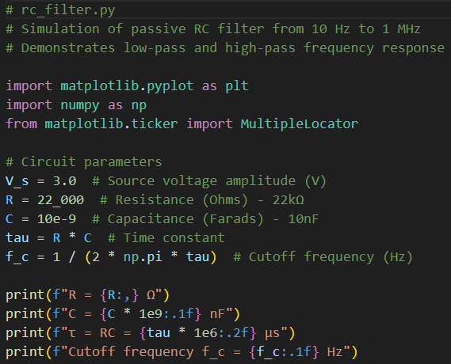
Open rc_filter.py
①
②
③
④

Slide 29
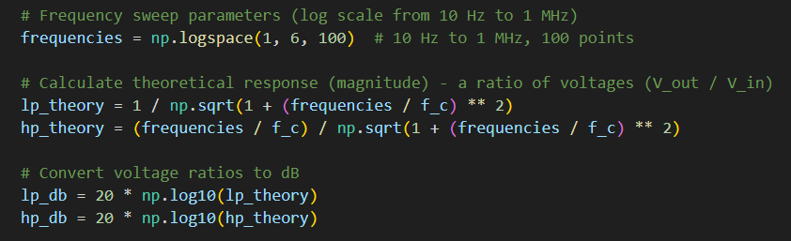
View rc_filter.py
①
②
③

Slide 30
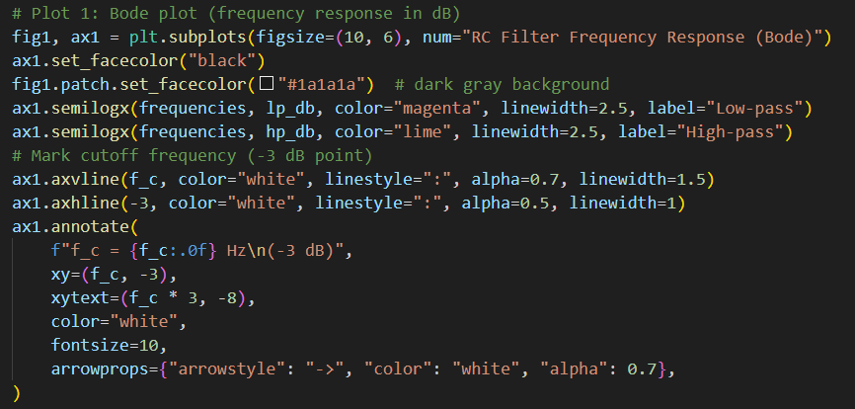
View rc_filter.py
①
It's named after Hendrik Wade Bode (1905–1982), an American engineer who worked at Bell Labs.

Slide 31
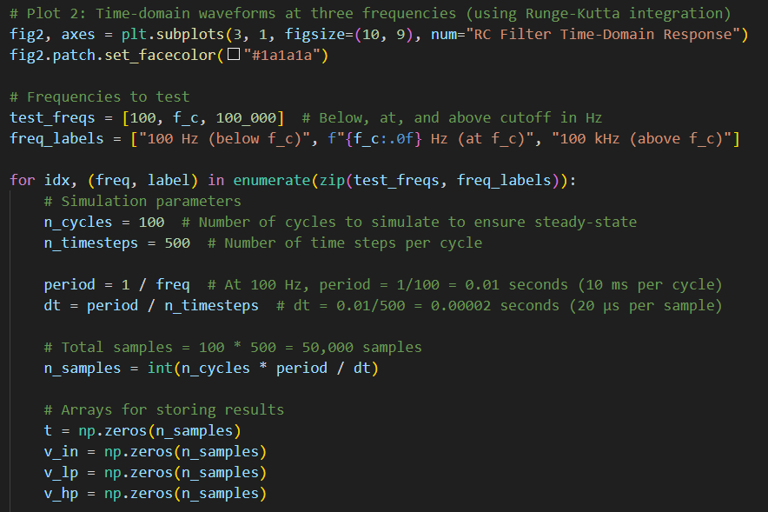
View rc_filter.py
①
②
③
④
⑤

Slide 32
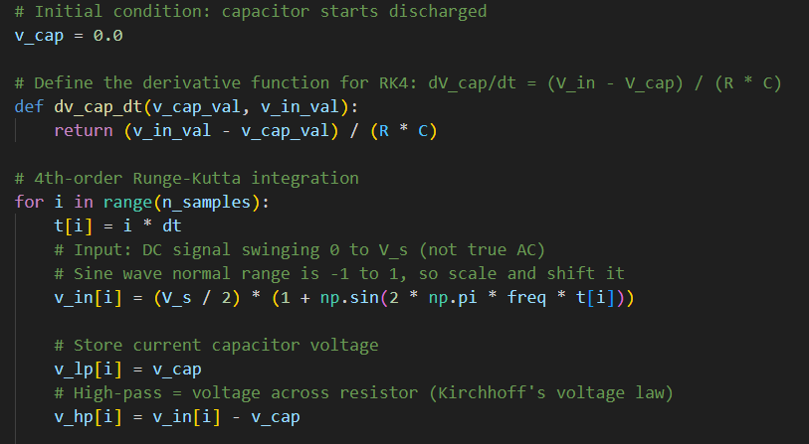
View rc_filter.py
①
②
AD9833 doesn’t emit negative volts
③
⑤
⑥

Slide 33
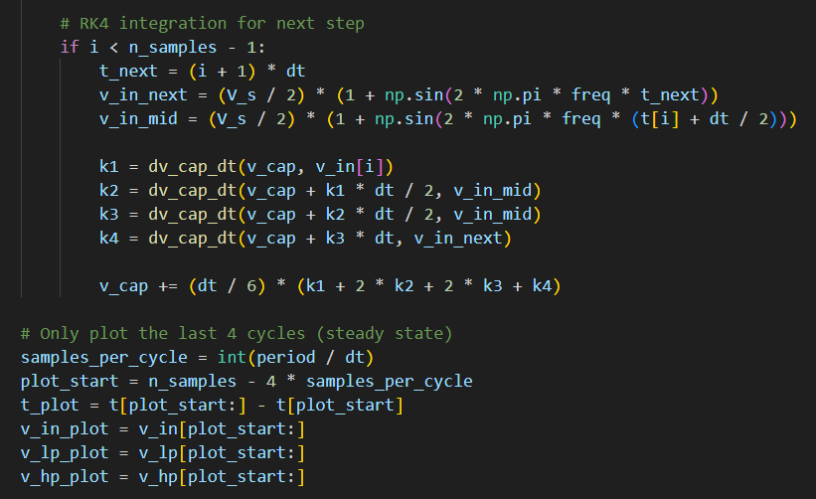
View rc_filter.py
①
②
③
④

Slide 34
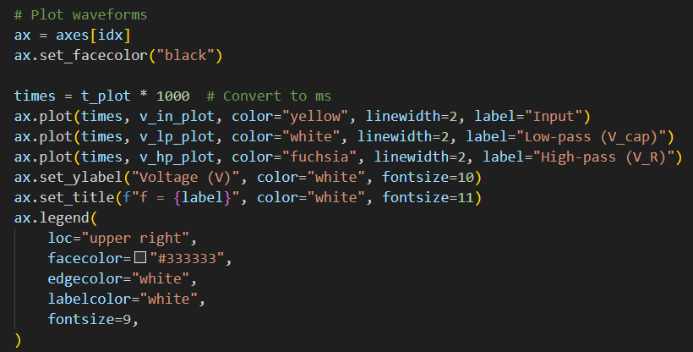
View rc_filter.py
①
②

Slide 35
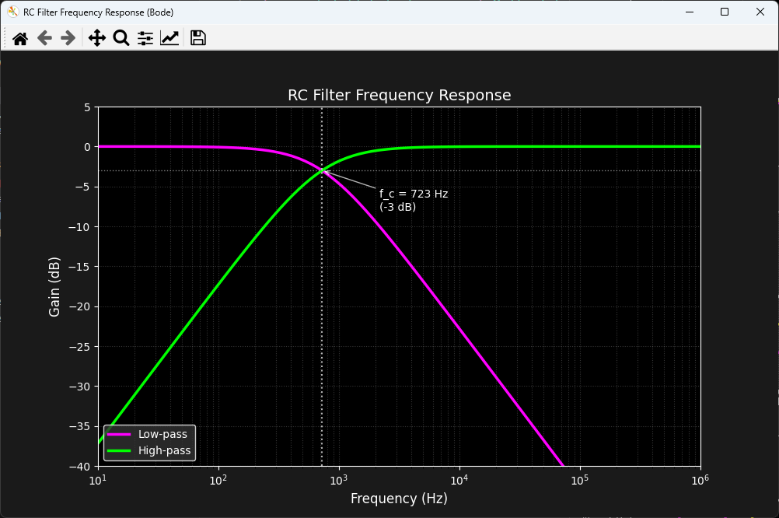
Run rc_filter.py

Slide 36
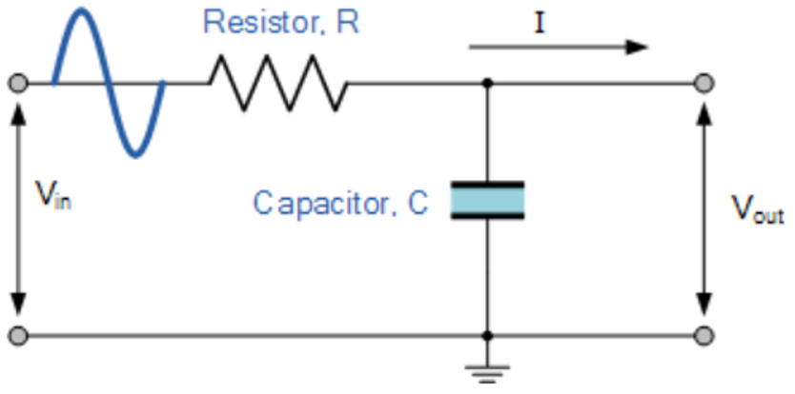


Check rc_filter.py
Low Freq
Low Freq
①
In LP filter – no current thru cap so V_cap follows V_in
In HP filter – little current thru cap, so low voltage across R
Mid Freq
②
Mid Freq
In LP filter – more current thru cap so voltage after cap is lower than V_in
In HP filter – cap is starting to pass current, so V_R starts to rise
High Freq
③
High Freq
In LP filter – Cap now full shunts AC to GND, so V_cap is just the DC of V_ins
In HP filter – All of V_in makes it to the R, but the cap only passes the AC of Vs

Slide 37
Combining a Low Pass and High Pass Filter
Combining a low-pass and high-pass filter allows you to isolate a specific range of frequencies, passing only those between the two cutoff points while attenuating everything above and below in frequency
By arranging the filters in parallel rather than series, signals can pass around a specific frequency range: the low-pass handles frequencies below the notch while the high-pass handles frequencies above, creating a rejection band in the middle
The Twin-T notch filter was developed by Herbert E. Kallmann in 1940 while working on television circuits; it could achieve a sharp notch using only passive components without inductors, which were bulky and expensive

Slide 38





A Twin-T Notch Filter
$$22 kΩ$$
$$22 kΩ$$
A Low Pass Filter
$$10 nF$$
$$10 nF$$
A High Pass Filter

Slide 39




Resistors and Capacitors in Parallel
$$22K$$
R / 2
$$11K$$
$$22K$$

Slide 40



Resistors and Capacitors in Parallel
$$10 nF$$
$$22K$$
R / 2
2C
$$11K$$
$$10 nF$$
$$22K$$
$$20 nF$$

Slide 41



A Twin-T Notch Filter
$$22 kΩ$$
$$22 kΩ$$
$$20 nF$$
$$10 nF$$
$$10 nF$$
$$11 kΩ$$

Slide 42

Square Wave – Odd Harmonics Only
As the harmonic number increases, each odd harmonic’s amplitude drops in proportion to 1/𝑛 (3rd: 0.333, 5th: 0.200, …).”

Slide 43


Board 05 Twin-T Filter
Op Amp (3.2x Gain)
Capacitors in Parallel = 2C
Resistors in Parallel = R/2

Slide 44
Notching Out the Fundamental Freq
Considering the tolerances of our capacitors and resistors, our Twin-T filter notches out frequencies somewhere between 651 – 811 Hz
Because of phase cancellation, a Twin-T notch filter can attenuate an input signal at the center frequency by -35 dB
Therefore, if we generate a pure sine wave at 723 Hz, we should not hear it pass through the Twin-T filter
But the higher-order odd harmonics of a square wave should pass through the filter
The Op Amp is there to amplify those higher harmonics of the square wave fundamental frequency, because their amplitudes fall off very quickly

Slide 45



-35 dB attenuation at the center frequency!
Capacitor tolerance of ±10% accounts for the shift in center frequency
My specific test breadboard performance

Slide 46
Unplug the MCU before changing any wiring!
As we move between each “experiment” on a given breadboard or switch to an entirely new Board #, it is crucial that you FIRST UNPLUG the USB cord!
I recommend unplugging the cord at the PC end – leave the cord connected to the Micro USB port on the Pico
It is dangerous to change any wiring while the MCU is still drawing power from your laptop’s USB port
If you incorrectly connect a jumper wire between the Pico and the breadboard while the Pico is drawing power from your PC, you can permanently damage your PC’s USB port
Have your partner double-check your wiring every step!

Slide 47

Wire Your Pico to Boards 04 and 05
Board 04
Board 05
Simply move the yellow jumper from Board 04 down to the tie point 21 on Board 05

Slide 48
Run notch_filter.py
Which wave type (tone) passes through the filter?
This would happen even if we just used a GPIO pin to manually create a square wave by alternatively raising and lowering the pin’s voltage (think how we manually blinked the RED LED on Board 01)
It is inescapable that the mere act of trying to make a square wave will generate sinusoidal higher odd harmonic waves
Mother Nature abhors square waves – they are not naturally occurring in any phenomenon
You are listening to a live demonstration of the Fourier Transform!

